Slide 1
Classification Task in Machine Learning

Slide 2
Introduction
Classification takes important part in Machine Learning
Aim is to categorize our output according to the input data
We are going to teach the computer with the input data(created by feature columns) therefore we will be able to predict the target column (usually «y» )
It can be binary(0 or 1- yes or no) type of classification also it is possible to have multi-class classification(more than 2)

Slide 3
Classification vs Regression
Both are:
Supervised learning algorithms
Use historical data to forecast and make decisions
Focus on fitting best fit line
Regression requires your data points to have continuous values. First the factors (independent variables) are found.
Classification requires your data points to have discrete values e.g. categories. First historic data is assigned into categories (classes).

Slide 4
Algorithms for Regression and Classification
Regression: Linear regression, Regression Forest, Regression Neural Networks.
Classification: K Nearest Neighbour, Logistic Regression, Support Vector Machines, Decision Trees

Slide 5
Overfitting is when model expressiveness is way too high. Overfitting is a condition when your model fits training data perfectly but when you test your model against test data then it performs bad. When you are training your model on training data and it builds its rules and patterns around the training data such that it is unable to generalise on unseen data

Slide 6
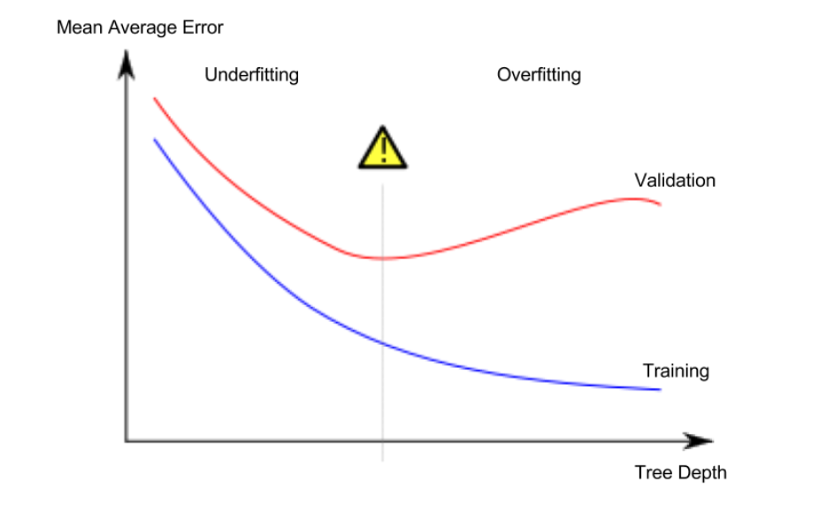

Slide 7
Linear Regression
Linear regression is used for finding linear relationship between target and one or more predictors. There are two types of linear regression- Binary and Multiple.
Binary is usefull when we want to find the relationship between 2 continuous variables.
Multiple is usefull when we have more than 2.
The core idea is to obtain a line that best fits the data. The best fit line is the one for which total prediction error (all data points) are as small as possible. Error is the distance between the point to the regression line.

Slide 8
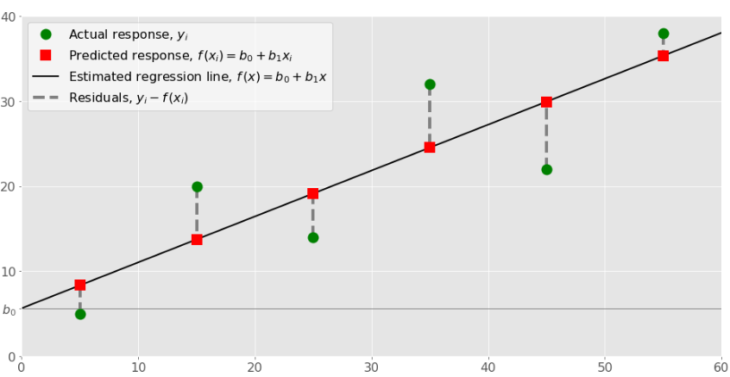
Linear Regression, Where can i use this?
Several examples are:
Engine performance from test data in automobiles.
Prediction of house prices in a city.
Marketing effectiveness, pricing and promotions on sales of a product.

Slide 9
Linear Regression Implementation
We are going to predict Avocado prices in Russia with the help of a dataset containing more than 18000 values within 14 features( columns
Use avocado.csv dataset
The code is in MLCourseAvocadoAVGPricesLinearRegression.ipynb file
We will calculate Mean Square Error and r2 score to check our prediction results.
We will draw a graph to visualize the prediction result.

Slide 10
Mean Square Error and R-squared (r2)
In statistics, the mean squared error (MSE) or mean squared deviation (MSD) of an estimator (of a procedure for estimating an unobserved quantity) measures the avg of the squares of the errors.
The mean squared error tells you how close a regression line is to a set of points.
R-squared is a statistical measure of how close the data are to the fitted regression line.

Slide 11
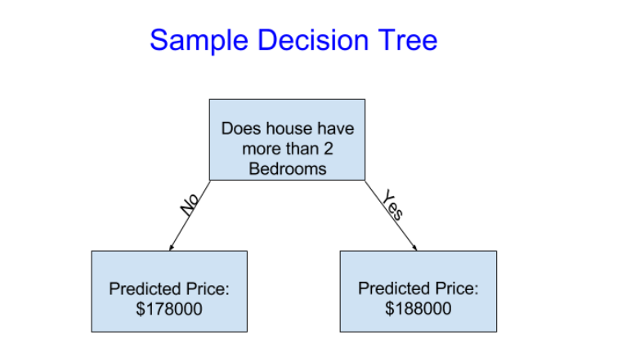
Decision Trees
A decision tree is a decision support tool that uses a tree-like graph or model of decisions and their possible consequences, including chance event outcomes, resource costs, and utility. It is one way to display an algorithm that only contains conditional control statements.

Slide 12
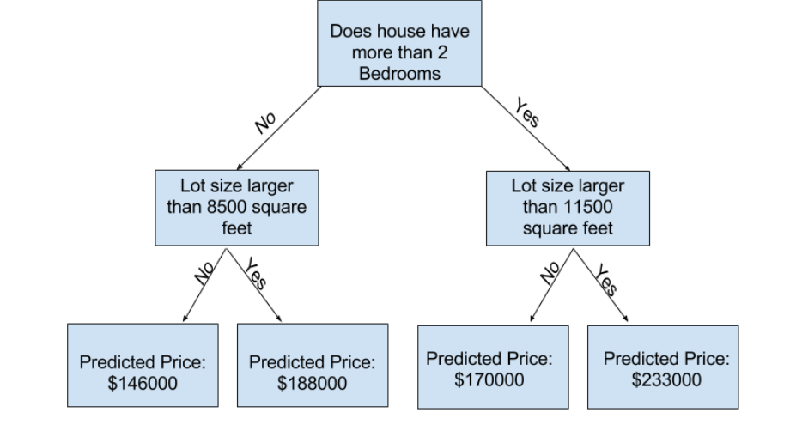
Improving the Decision Tree

Slide 13
Gradient Descent Algorithm
Gradient descend is an optimization algorithm. It aims to find points of a function that minimize its errors. Gradient descend is used in almost all of the machine learning algorithms. When a machine learning algorithm works on a data, we can find its cost function to estimate how good the algorithm is. The cost function tracks the prediction errors in the algorithm. Predictive power of a machine learning algorithm(ACCURACY) can be improved by changing its parameters. We can iteratively change the parameters(parameter tuning) until the cost function is at its lowest point implying that the accuracy of the model is at its maximum.

Slide 14
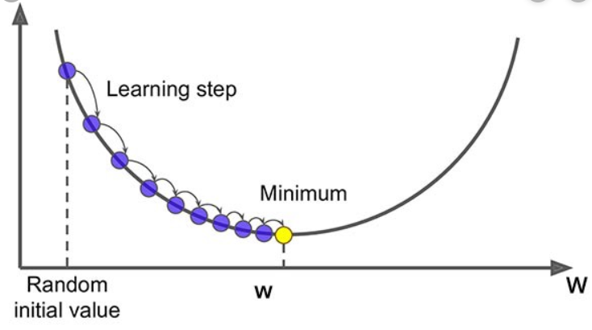
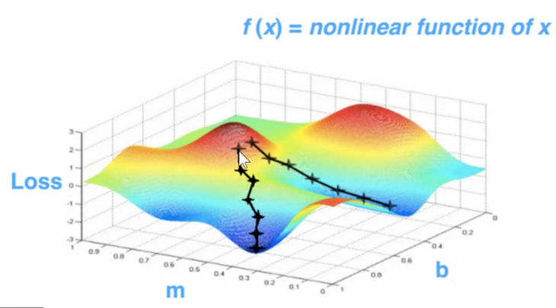
Question. What can be the problem in the gradient descent graph(Rightside)?

Slide 15
To perform classification into the data, we will be using supervised learning methods.
This means, we will be having training and test sets.
We will use the training set for the learning
We will use the test set for validation(did we manage to teach?)
We will use train-test data split(%70 training-%30 test set)
We will use a real dataset and perform classification.

Slide 16
Classification for a Dataset
#Data set contains numerical data for the features
# The goal is to classify the person has diabet(1) or not(0)
#Support Vector Machine will be the algorithm
import numpy as np
import pandas as pd
dataset = pd.read_csv("diabetes.csv")
X = dataset.drop('Outcome',axis=1)
Y = dataset['Outcome'] # remember that Outcome is our target column

Slide 17
dataset.head() # visualize your dataset(only first 5 rows)
from sklearn.model_selection import train_test_split
x_data = dataset.drop('Outcome',axis=1) # drop your target column
y_labels = dataset['Outcome'] # your target column must be alone
X_train, X_test, y_train, y_test = train_test_split(x_data,y_labels,test_size=0.3,random_state=42)
# you need to have you training features in X values- target values in y #values!

Slide 18
from sklearn.svm import SVC # import SVM
svclassifier = SVC(kernel='linear') # SVM has kernels- choose «linear»
svclassifier.fit(X_train, y_train) #fit your model with Support Vector
y_pred = svclassifier.predict(X_test) # predict according to your y data
#Y’s are your target values that you want to predict&classify

Slide 19
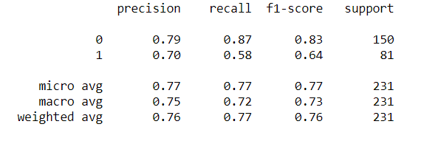
Evaluation
from sklearn.metrics import classification_report, confusion_matrix
print(confusion_matrix(y_test,y_pred)) # print your accuracy
print(classification_report(y_test,y_pred)) # print your accuracy

